Slide 1

WEEK 10
Segmentation
Computer Modelling
Technical University of Košice
Faculty of Electrical Engineering and Informatics

Slide 2

Today's Agenda
01
04
Motivation & Applications
Case Study: nnU-Net
Medical imaging, natural images
Self-configuring segmentation
02
05
U-Net Architecture
Lab 10
Encoder-decoder with skip connections
Implement segmentation & losses
03
Loss Functions
Input → Label Map (H × W × C)
Dice, Tversky, Hausdorff, compound

Slide 3
What is Segmentation?
Key concept: Moving from classification (Input → Class Label) to pixel-wise labeling (Input → Label Map of H × W × C)
Semantic Segmentation
Instance Segmentation
Panoptic Segmentation
Same class = same label. All "cars" get the same color regardless of instance.
Each object instance gets a unique ID. Car₁ ≠ Car₂, even though both are "car".
Combines both: instances for "things" (countable) + semantic for "stuff" (sky, road).
Challenge: Standard CNNs aggressively downsample (pooling) to gain large receptive fields, losing spatial resolution needed for precise segmentation.

Slide 4
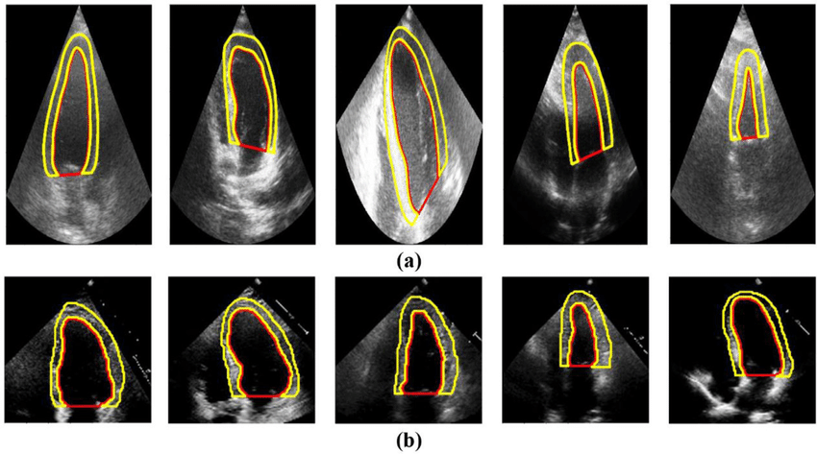
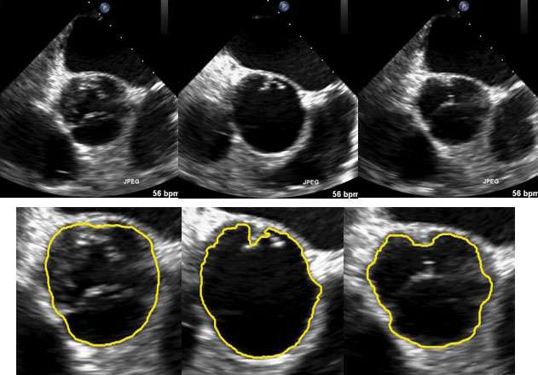
Medical Imaging Applications
CAMUS — Cardiac Ultrasound
Why It Matters
– Quantitative analysis
– Treatment planning
– Faster annotation
Echo Segmentation
Key Datasets
CAMUS: Cardiac ultrasound
BraTS: Brain tumors
Decathlon: 10 tasks
ACDC: Cardiac MRI

Slide 5
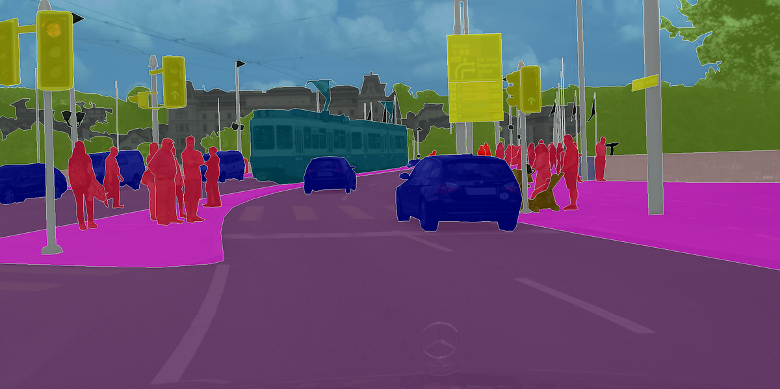
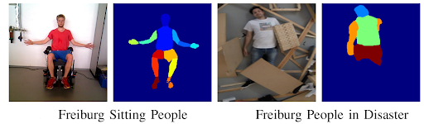
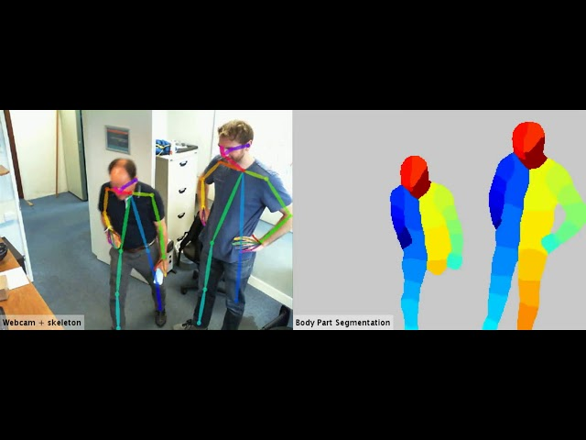
Natural Image Applications
Cityscapes — Urban Scene
Freiburg — Body Segmentation
Real-Time Body Segmentation
Autonomous driving, 30 classes
Human parsing, fitness, AR
Video processing, gaming
Key Applications: Autonomous Driving, Robotics, Image Editing, Satellite Imagery
150+
ADE20K classes

Slide 6

The U-Net Architecture
Encoder (Contracting Path)
Conv → Conv → MaxPool (×4). Captures "what" is in the image through increasing receptive field.
Bottleneck
Deepest feature maps with largest receptive field. Global context representation.
Decoder (Expanding Path)
TransConv/Upsample → Concat → Conv → Conv (×4). Recovers "where" with precise localization.
Key innovation: Skip connections concatenate encoder features with decoder features, preserving spatial details lost during downsampling.
Why It Works
– Symmetric structure enables end-to-end training
– Skip connections solve vanishing gradients
– Works well with limited training data
– Foundation for modern architectures (nnU-Net)

Slide 7
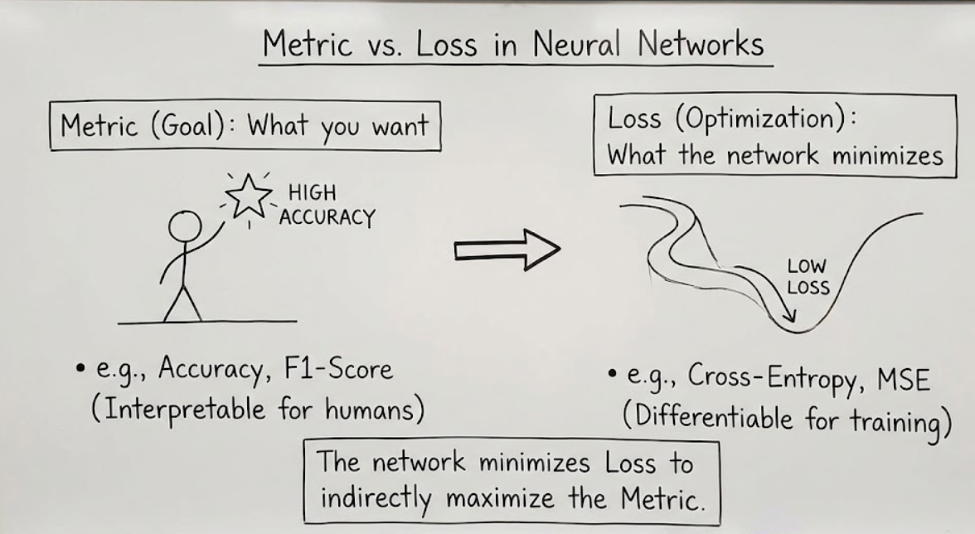
Metrics vs. Loss Functions
Metric vs. Loss in Neural Networks
📊 Metric (Goal)
📉 Loss (Optimization)
What you want to achieve
What network optimizes
Characteristics:
Characteristics:
– Interpretable for humans
– Must be differentiable
– Often non-differentiable
– Enables backpropagation
– Used for evaluation
– Proxy for the goal
Examples:
Examples:
– Accuracy, F1, IoU
– Cross-Entropy, MSE
– Hausdorff Distance
– Dice, Tversky Loss
Key insight: The loss should be a differentiable approximation of what you care about (the metric).

Slide 8


Dice Loss
Dice Coefficient (Metric)
Why Dice Over Cross-Entropy?
Class imbalance: Medical images often have small foreground regions (e.g., tumors). CE treats all pixels equally.
Dice: Directly optimizes overlap, naturally handles imbalance by focusing on the intersection.
Dice Loss (Differentiable)
Soft Dice (for training)
Uses predicted probabilities (0-1) instead of binary predictions. Intersection becomes element-wise product sum.
Venn Diagram Interpretation
⚠️ Limitations
A = Predicted
– Training instability when very small regions
B = Ground Truth
A ∩ B = Overlap
– Doesn't distinguish FP from FN
– Smoothing term (ε) needed for stability

Slide 9



Generalized Dice Loss
Problem Solved
Generalized Dice Loss Formula
Standard Dice averages equally across classes. In multi-class segmentation with extreme imbalance, large classes dominate the loss. GDL re-weights classes inversely to their frequency.
Key Properties
Class weight calculation:
– Single scalar loss for all classes
– Automatic weight computation
– Gradient magnitude balanced across classes
– Common in medical imaging (BraTS)
Class Weight Visualization
Background
w = 0.01
Use When:
Class 1
w = 0.15
✓ Multi-class segmentation
Tumor
w = 0.84
✓ Highly imbalanced class sizes
Smaller classes receive higher weights
✓ Small structures matter (tumors, lesions)
✓ Want single loss value to optimize

Slide 10



Tversky Loss
Not every class label error matters the same!
Parameters α and β
Tversky Index
α + β = 1 for balanced behavior
α = β = 0.5 → equivalent to Dice
β > α → penalize FN more (recall↑)
High α (penalize FP)
High β (penalize FN)
Reduce over-segmentation. Use when false alarms are costly.
Catch everything! Use when missing targets is dangerous.
Medical Example: Tumor Detection
Missing a tumor (FN) is worse than flagging healthy tissue (FP). Set β = 0.7, α = 0.3 to prioritize sensitivity/recall.
False Positive
False Negative
Focal Tversky Loss
Add focal parameter γ to focus on hard examples:
Predicted more than GT
Missed part of GT
FTL = (1 - TI)γ

Slide 11



Hausdorff Distance Metric
⚠️ Not Symmetric!
Directed HD: h(A,B) ≠ h(B,A). Always compute both directions and take max for fair comparison.
Directed Hausdorff Distance
Why Hausdorff?
– Measures boundary accuracy
– Catches outliers that Dice misses
– Critical for surgical planning
Symmetric Hausdorff Distance
HD95 (95th Percentile)
Standard HD is sensitive to single outliers. HD95 uses the 95th percentile distance, making it more robust while still capturing boundary quality.
Boundary Distance: Measures worst-case boundary alignment
Ground Truth
Prediction
Max Distance
Using as a Loss?
HD itself is not differentiable.
Use boundary-based losses as proxies: Distance Transform Loss, Boundary Loss, Surface Loss. These approximate HD while enabling gradient computation.

Slide 12


Compound Losses
Combining multiple loss functions for better performance
Most common combination in medical imaging (nnU-Net default)
Cross-Entropy Contribution
Dice Contribution
Combined = Best of Both
✓ Stable gradients early in training
✓ Handles class imbalance
✓ Stable training throughout
✓ Pixel-wise supervision
✓ Direct overlap optimization
✓ Better class balance
✓ Well-calibrated probabilities
✓ Better final segmentation quality
✓ Higher final Dice scores
✓ Works even with empty masks
✓ Focuses on foreground regions
✓ Robust across datasets
Weighting: Can use λ·L + (1-λ)·L. Often λ=0.5 works well, or start with more CE weight and anneal.
Variants: CE + Tversky, CE + Focal Dice, TopK CE + Dice. Experiment based on your specific data characteristics.

Slide 13
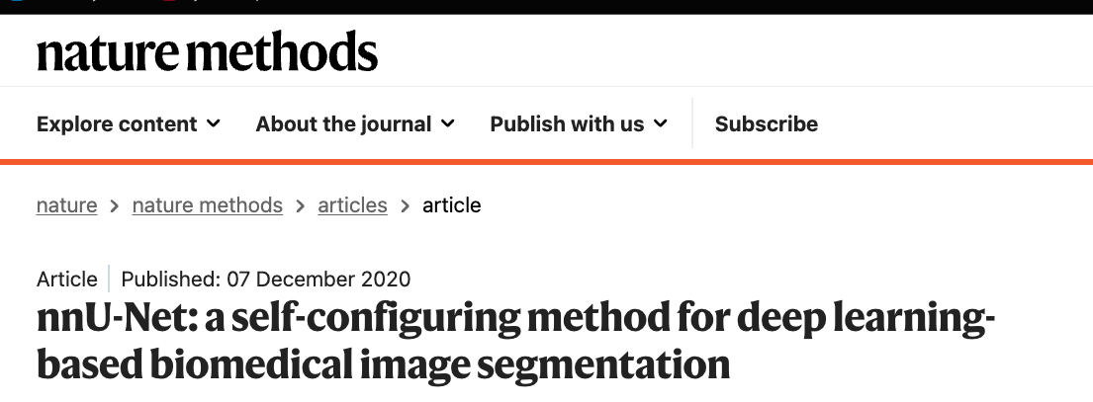
Case Study: nnU-Net
🎯 Core Philosophy
Preprocessing, training, inference matter more than architecture.
📊 Data Fingerprint
Sizes
Spacing
Intensity
Classes
📄 Nature Methods 2021
🏆 Impact
23
0
5K+
Decathlon wins
Manual tuning
GitHub stars
📋 Training Recipe
– Loss: CE + Dice
– SGD + momentum, 1000 epochs
– Heavy data augmentation
🤖 Automatic Decisions
Topology: Depth, pooling operations
Patch size: Maximized for GPU memory
Resampling: Target spacing decision
Normalization: Per-modality strategy

Slide 14
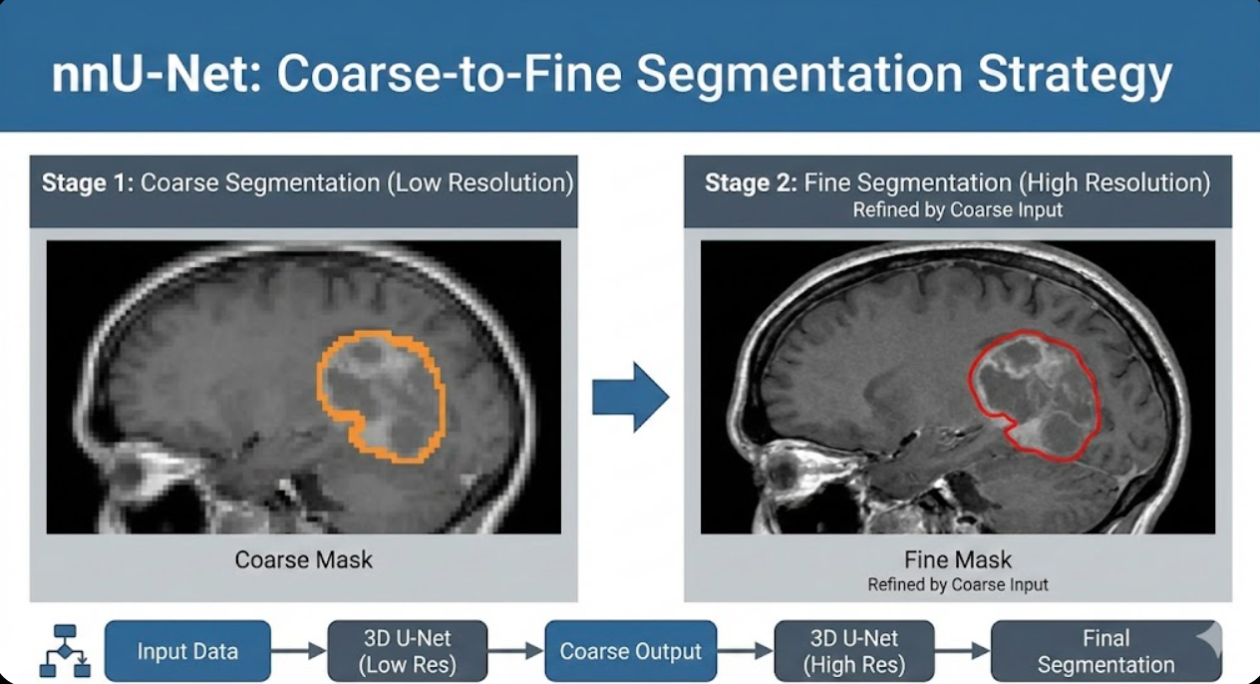

nnU-Net: Three Configurations
2D U-Net
3D Full-Resolution
3D Cascade
Slice-by-slice. Fast training. ⚠️ No Z context
Full volume. Best accuracy. ⚠️ High memory
Coarse→fine. ✓ Best for large images
Coarse-to-Fine Segmentation Strategy
Stage 1: Low-res localization → Stage 2: High-res refinement
🎲 Automatic Selection
📊 Ensemble Boost
Trains all configs, cross-validates, picks best or ensembles them.
Combining predictions from multiple configs gives +1-2% Dice.

Slide 15
Beyond U-Net: Modern Architectures
DeepLab v3+
Attention U-Net
TransUNet / Swin-UNETR
Atrous Spatial Pyramid Pooling
Gated Skip Connections
Transformer-based Encoders
Multi-scale context via dilated convolutions
No resolution loss from pooling
Encoder-decoder with ASPP module
Best for: Large receptive field needs
Attention gates filter skip connections
Focus on relevant spatial regions
Suppresses irrelevant features
Best for: Variable-size structures
Global self-attention mechanisms
CNN encoder + Transformer layers
Better long-range dependencies
Best for: Large 3D medical volumes
Key insight: Architecture choice depends on your data. Start with nnU-Net, then try specialized architectures if needed.

Slide 16
Data Augmentation for Segmentation
CRITICAL: Spatial transforms must be applied identically to image AND mask!
Spatial Transforms
Intensity Transforms
Recommended Libraries
Elastic Deformation
Brightness/Contrast
MONAI
Simulates tissue deformation. Essential for medical imaging.
Simulates scanner variations. Image only!
Medical imaging. 3D support. Dict transforms for image+mask pairs.
Affine (Rotation, Scale, Shear)
Gaussian Noise
Standard geometric augmentations. Use reasonable ranges.
Adds robustness to noisy inputs.
Albumentations
Flipping (H/V)
Gaussian Blur
Fast. 2D focused. Great for natural images.
Free augmentation. Check anatomical validity first!
Simulates motion artifacts, focus issues.
TorchIO
Random Crop + Resize
Gamma Correction
3D medical. Queue-based sampling.
Forces model to work at multiple scales.
Non-linear intensity changes.
nnU-Net augmentation: Rotation, scaling, noise, blur, brightness, contrast, gamma, mirroring, elastic deformation

Slide 17
Post-Processing Techniques
Refining predictions after the network — often gives +1-3% Dice improvement
Connected Components
Morphological Operations
Test-Time Augmentation
Remove small spurious predictions by keeping only the largest connected component(s).
Clean up boundaries and fill holes using erosion, dilation, opening, closing.
Run inference multiple times with augmentations, average the predictions.
from scipy.ndimage import label
Closing = Dilate then Erode (fills small holes)
Apply N augmentations (flips, rotations)
Get predictions for each
Reverse augmentations
Average probabilities then threshold
labeled, n = label(pred)
Opening = Erode then Dilate (removes noise)
sizes = [np.sum(labeled==i)
Hole filling = binary_fill_holes()
keep = np.argmax(sizes) + 1
When: Noisy boundaries, internal holes
When: Single structure expected (liver, heart)
nnU-Net uses 8x TTA by default (mirroring)
Caution: Post-processing adds assumptions. Always validate on held-out data. What helps on one dataset may hurt on another.

Slide 18
Loss Selection Guide
A practical decision framework for choosing segmentation losses
START: What is your main challenge?
Class Imbalance?
FP/FN Tradeoff?
Boundaries Matter?
Stable Training?
Small foreground, large background
Missing targets vs. false alarms
Precise edges needed
General purpose, robust
Use Dice Loss
Use Tversky Loss
Add Boundary Loss
Use CE + Dice
Multi-class? Use GDL
beta > 0.5 for recall up
Or Surface Loss, HD Loss
nnU-Net default
Default recommendation: Start with CE + Dice (lambda=0.5). It works well for most cases. Only switch if you have a specific problem to solve.
Advanced Combos
CE + Focal Tversky | TopK CE + Dice | Dice + Boundary

Slide 19
Common Pitfalls
Mistakes that trip up every segmentation practitioner (and how to avoid them)
Empty Mask NaN
Augmentation Mismatch
Dice with empty GT causes division by zero. Add smoothing: epsilon = 1e-6
Rotating image but not mask = misaligned labels. Use paired transforms (MONAI Dict transforms).
Logits vs Probabilities
nn.CrossEntropyLoss expects raw logits! Dice expects probabilities (after softmax/sigmoid). Mixing these = silent bugs.
Interpolation for Masks
Never use bilinear/bicubic for masks! Creates invalid values (0.5 classes?). Always use nearest neighbor.
Channel Dimension Mismatch
Pred: (B, C, H, W) vs GT: (B, H, W)? GT should be class indices OR one-hot encoded. Check your loss format!
Data Leakage in Splits
Patient A slices in train AND test = cheating! Split by patient/study, not by slice/image.
Pro tip: Print shapes religiously during debugging. print(pred.shape, gt.shape, pred.min(), pred.max())

Slide 20

The Future: Foundation Models
MEDICAL ADAPTATION
MedSAM
META AI - 2023
SAM fine-tuned on 1.5M medical image-mask pairs across 10+ modalities.
Segment Anything (SAM)
Nature Communications 2024
Trained on 11M images, 1B+ masks. Promptable segmentation with points, boxes, or text.
What This Means For You
Zero-shot segmentation
Interactive prompting
Any object, any domain
Struggles with medical imaging
Task-specific models (nnU-Net) still win benchmarks
Foundation models excel at annotation assistance
Future: Fine-tune foundation models for your task
Resources: segment-anything.com | github.com/bowang-lab/MedSAM | SAM 2 | Also see: SEEM, SegGPT, UniverSeg

Slide 21
Lab 10: Hands-On Plan
💡 Implementation Tips
1
Build Segmentation Network
– Use soft predictions (probabilities) for Dice
– Add small ε (1e-6) for numerical stability
Implement U-Net or similar architecture for multi-class segmentation: cats, dogs, background, and boundaries.
– Remember: CE expects logits, Dice expects probs
– Boundaries are hard — consider class weighting
2
Implement Loss Functions
📋 Deliverables
✓ Working segmentation model
Code Dice Loss and Cross-Entropy from scratch — no MONAI/torch.nn losses allowed. Understand the math!
✓ Manual Dice loss implementation
✓ Manual CE loss implementation
✓ Training curves & sample predictions
Target Classes:
⚠️ No Shortcuts!
Cat
Dog
Background
Boundary
The goal is to deeply understand loss functions. Using nn.CrossEntropyLoss or monai.losses.DiceLoss defeats the purpose. Implement them yourself!

Slide 22
Key Takeaways
01
03
Segmentation = Dense Prediction
Metrics ≠ Losses
Every pixel gets a label. Encoder-decoder architectures (U-Net) recover spatial resolution lost during feature extraction.
Metrics evaluate (IoU, Hausdorff), losses optimize (differentiable). Design losses that approximate what you care about.
02
04
Loss Functions Matter
nnU-Net = Strong Baseline
Dice handles imbalance, Tversky controls FP/FN tradeoff, compound losses combine benefits. Choose based on your data.
Auto-configures everything from your data fingerprint. Use it as starting point or benchmark for medical imaging.
Next week: Put it into practice — implement your own losses and see how they affect training dynamics! 🚀

